Slide 1
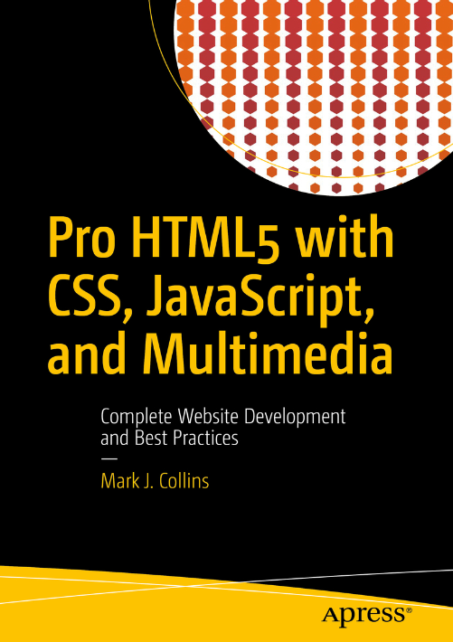
CW412 part ii

Slide 2
COURSE OUTLINE
PART I HTML5 Technologies | PART II HTML | PART III CSS | PART IV JAVASCRIPT | PART V Advanced Applications
Chapter 1:​ Hypertext Markup Language | Chapter 4:​ Structural HTML Elements | Chapter 9:​ CSS Selectors | Chapter 16:​ Browser Environment | Chapter 21:​ Audio and Video
Chapter 2:​ Cascading Style Sheets | Chapter 5:​ Phrasing HTML Elements | Chapter 10:​ Positioning | Chapter 17:​ Window Object | Chapter 22:​ Scalable Vector Graphics
Chapter 3:​ JavaScript Essentials | Chapter 6:​ Table HTML Elements | Chapter 11:​ Text Styles | Chapter 18:​ DOM Elements | Chapter 23:​ Canvas
 | Chapter 7:​ Embedded HTML Elements | Chapter 12:​ Borders and Backgrounds | Chapter 19:​ Dynamic Styling | Chapter 24:​ Drag and Drop
 | Chapter 8:​ HTML Form Elements | Chapter 13:​ Styling Tables | Chapter 20:​ Events | Chapter 25:​ Indexed DB
 |  | Chapter 14:​ Flexbox |  | Chapter 26:​ Geolocation and Mapping
 |  | Chapter 15:​ Animation and Transforms
2022 CTU Training Solutions | All Rights Reserved | ctutraining.ac.za

Slide 3

PART ii: OBJECTIVES
Apply HTML Elements
Understanding HTML Table and Form Elements
Embed HTML Elements
2022 CTU Training Solutions | All Rights Reserved | ctutraining.ac.za
Notes:
This learning unit explores further the HTML elements, on how to define the structure and the content of a webpages.
We explore HTML tables, which are used to display data in rows and columns.
Lastly, we focus on the HTML forms elements, which are used to collect user information.

Slide 4

apply HTML elements.
OBJECTIVE 1

Slide 5
Part I | Using HTML5 Semantic mark-up
Main Heading | Subheading
Semantics is the study of the meanings of words and phrases in a language.
A semantic element clearly describes its meaning to both the browser and the developer.
Examples of non-semantic elements: <div> and <span> - Tells nothing about its content.
Examples of semantic elements: <form>, <table>, and <article> - Clearly defines its content.
Before creating a new web page, it’s a good idea to sketch out the basic page structure. This will help you visualize the overall layout and see how the elements are nested together.
2020 CTU Training Solutions | All Rights Reserved | ctutraining.ac.za
2022 CTU Training Solutions | All Rights Reserved | ctutraining.ac.za

Slide 6
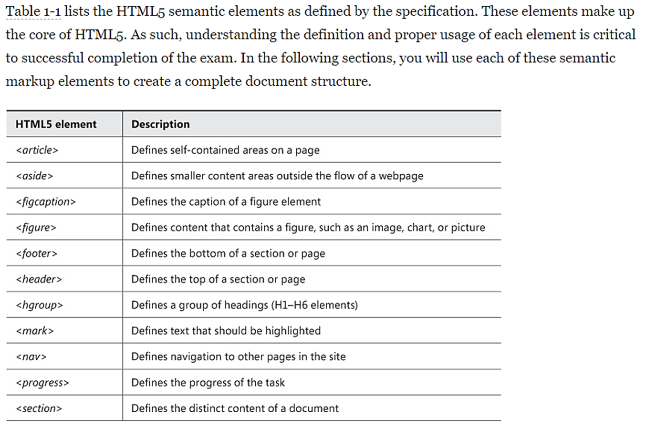
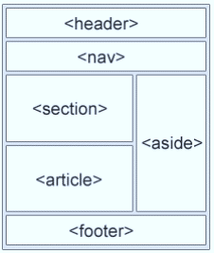
Part I | Using HTML5 Semantic mark-up
Main Heading | Subheading
2020 CTU Training Solutions | All Rights Reserved | ctutraining.ac.za
2022 CTU Training Solutions | All Rights Reserved | ctutraining.ac.za

Slide 7
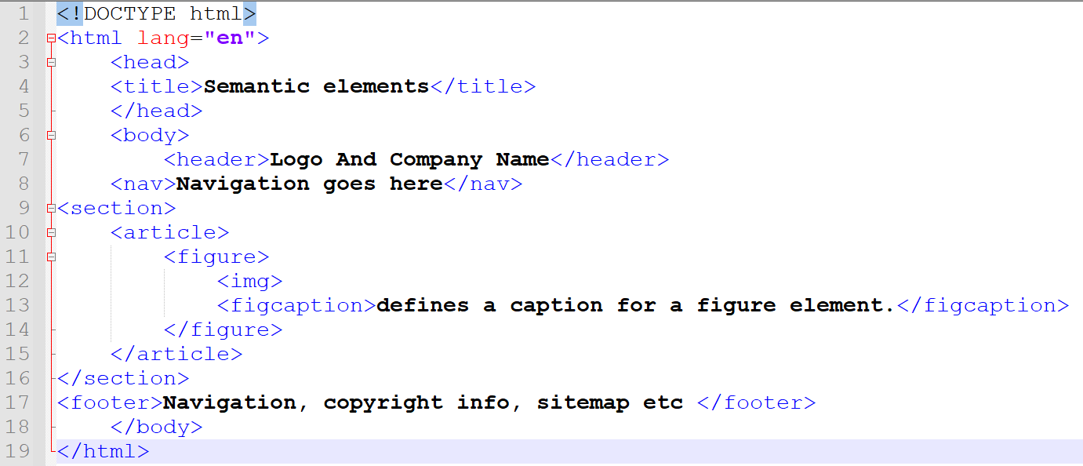
Part II | Semantic Elements
Main Heading | Subheading
2020 CTU Training Solutions | All Rights Reserved | ctutraining.ac.za
2022 CTU Training Solutions | All Rights Reserved | ctutraining.ac.za

Slide 8
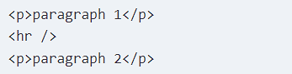
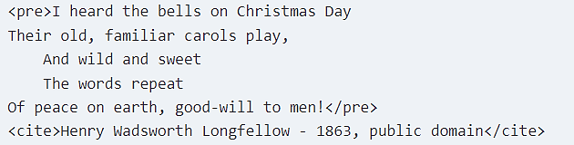
Part II | HTML Elements
Horizontal Rule
In HTML4, the hr element was used to create a horizontal rule, or line. Since HTML5 provides more semantic definition to its elements, this has been redefined as a thematic break. This is usually placed between paragraphs when there is a change of topic.
Preformatted
Content placed inside a preformatted (pre) element will be rendered just like it is entered, including white space. White space, including carriage returns, tabs, and extra spaces, are normally ignored by the browser. Use the pre element to tell the browser to include them.
Main Heading | Subheading
2020 CTU Training Solutions | All Rights Reserved | ctutraining.ac.za
2022 CTU Training Solutions | All Rights Reserved | ctutraining.ac.za

Slide 9
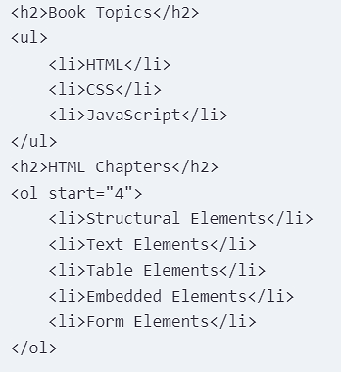
Part II | Listing Elements
HTML5 supports both an ordered list using the ol element as well as an unordered list using the ul element. They work pretty much the same except for a few additional attributes that are available with an ordered list.
The type attribute specifies what type of
“numbering” to use. Here are the supported values:
1 - Use numbers (this is the default value if not specified)
A - Use uppercase letters (e.g., A, B, C, D)
a - Use lowercase letters
I - Use Roman numerals with uppercase letters (e.g., I, II, III, IV)
i - Use lowercase Roman numerals
Main Heading | Subheading
2020 CTU Training Solutions | All Rights Reserved | ctutraining.ac.za
2022 CTU Training Solutions | All Rights Reserved | ctutraining.ac.za

Slide 10
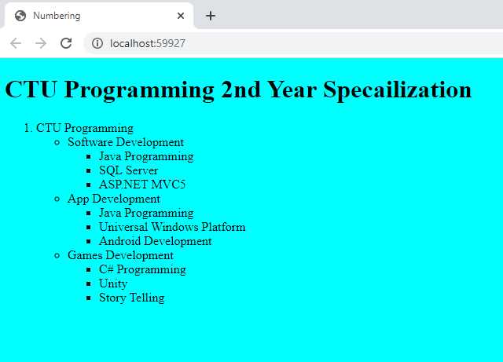
Part II | You do it !!!
Notes:
Student Activity

Slide 11
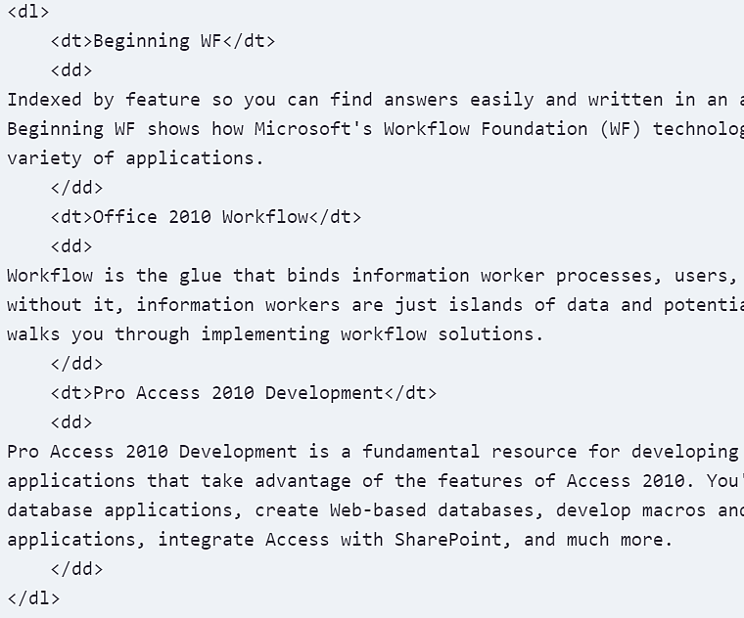
Part II | Description List
The description list (dl) element is used define a list of terms. It is implemented as a set of name/value pairs. It is often used to create a glossary. In this case the names are the terms being defined and the values are the definition or description of those terms. You can put series of term (dt) elements and description (dd) elements inside the dl element..
Main Heading | Subheading
2020 CTU Training Solutions | All Rights Reserved | ctutraining.ac.za
2022 CTU Training Solutions | All Rights Reserved | ctutraining.ac.za

Slide 12
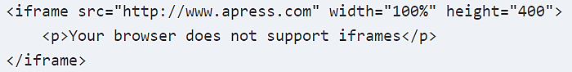
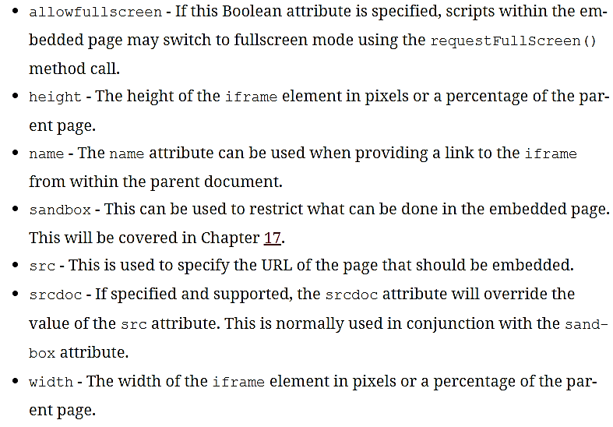
Part II | Inline Frames
The iframe element is used to embed another web page within the current document. You can include an iframe with markup like this:
The iframe element supports several attributes that you can use to configure how the element is rendered and what options it will allow.
Main Heading | Subheading
2020 CTU Training Solutions | All Rights Reserved | ctutraining.ac.za
2022 CTU Training Solutions | All Rights Reserved | ctutraining.ac.za
Notes:
Iframe - Imbedding another web inside your web.

Slide 13
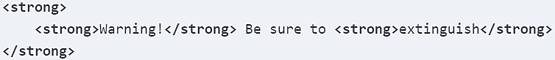
Part II | Phrasing HTML Elements
Main Heading | Subheading
The strong element is used to indicate the text has a higher importance than the surrounding text. This could be a word, phrase, sentence, or even paragraph that is critical.
Text placed within an em element should be read with emphasis. Even though you may not be reading the text out loud, in your mind you’re still hearing the emphasis and catching the nuances implied by it.
The <mark> tag defines text that should be marked or highlighted.
The i element should be used when the text needs to be styled differently from the surrounding text.
The small element for copyright information, disclaimers, or other legal information.
The strikethrough element (s) is used to indicate content that is no longer relevant or accurate.
Stylistically offset - <b> - keywords or other phrases that need to stand out
Unarticulated - <u> - indicates spelling, grammatical errors or proper nouns.
2020 CTU Training Solutions | All Rights Reserved | ctutraining.ac.za
2022 CTU Training Solutions | All Rights Reserved | ctutraining.ac.za

Slide 14
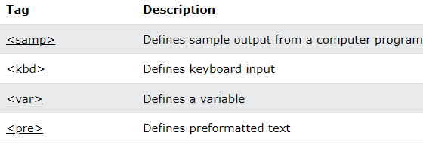
Part II | Phrasing HTML Elements
Main Heading | Subheading
The <code> tag is used to define a piece of computer code. The content inside is displayed in the browser's default monospace font.
The <abbr> tag defines an abbreviation or an acronym, like "HTML", "CSS", "Mr.", "Dr.", "ASAP", "ATM".
The <sub> tag defines subscript text. Subscript text appears half a character below the normal line.
The <time> tag defines a specific time (or datetime).
The <q> tag defines a short quotation.
The <span> tag is an inline container used to mark up part of text, or part of document.
2020 CTU Training Solutions | All Rights Reserved | ctutraining.ac.za
2022 CTU Training Solutions | All Rights Reserved | ctutraining.ac.za

Slide 15
Understanding HTML Table and Form Elements.
OBJECTIVE 2

Slide 16
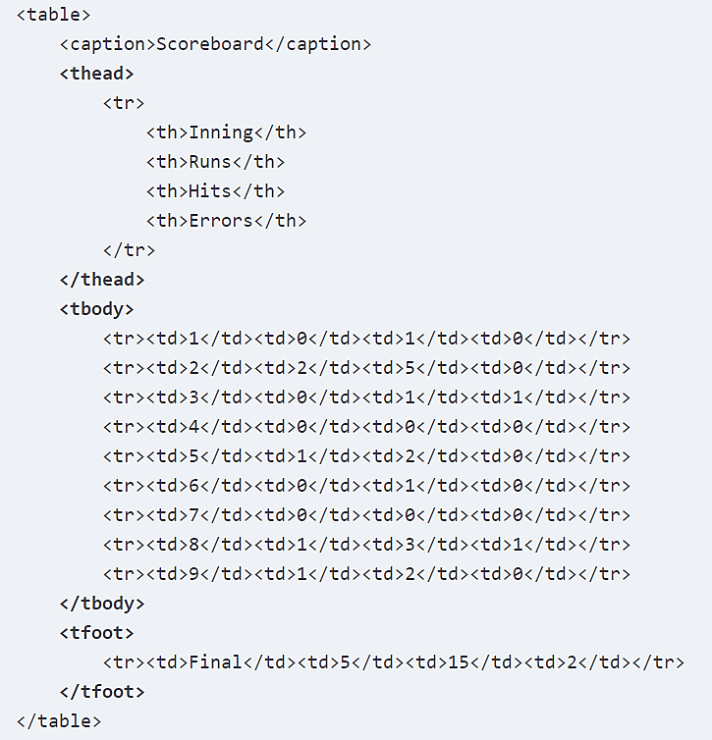
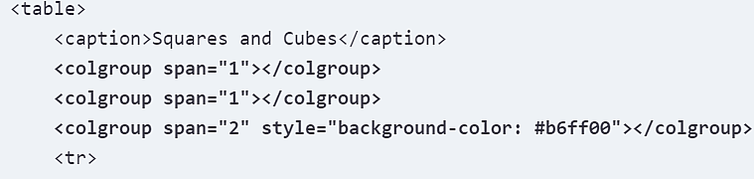
Part II | Table Element
Main Heading | Subheading
The <table> tag defines an HTML table.
An HTML table consists of one <table> element and one or more <tr>, <th>, and <td> elements.
The <tr> element defines a table row, the <th> element defines a table header, and the <td> element defines a table cell.
An HTML table may also include <caption>, <colgroup>, <thead>, <tfoot>, and <tbody> elements.
2020 CTU Training Solutions | All Rights Reserved | ctutraining.ac.za
2022 CTU Training Solutions | All Rights Reserved | ctutraining.ac.za

Slide 17
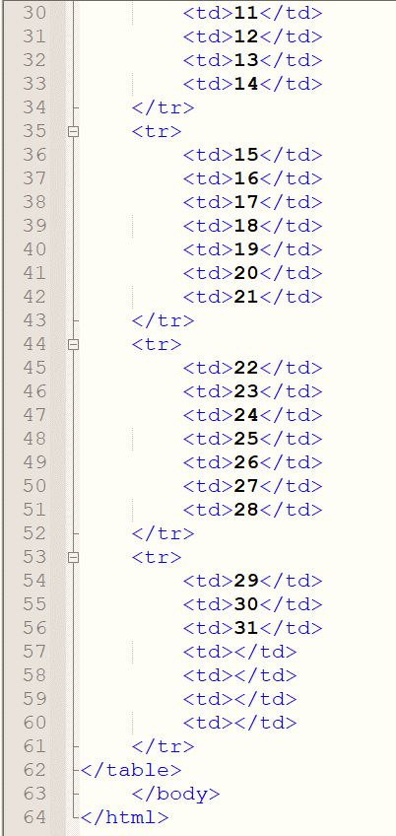
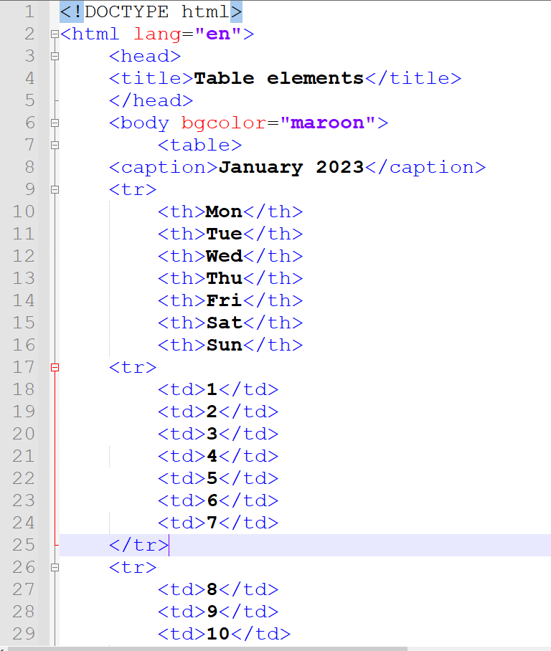
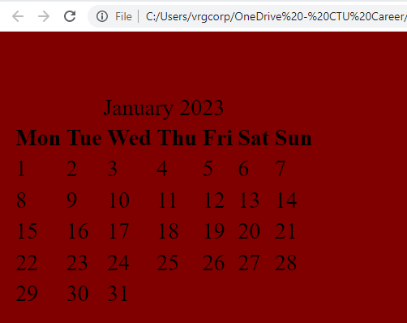
Part II | Table Element
Main Heading | Subheading
2020 CTU Training Solutions | All Rights Reserved | ctutraining.ac.za
2022 CTU Training Solutions | All Rights Reserved | ctutraining.ac.za

Slide 18
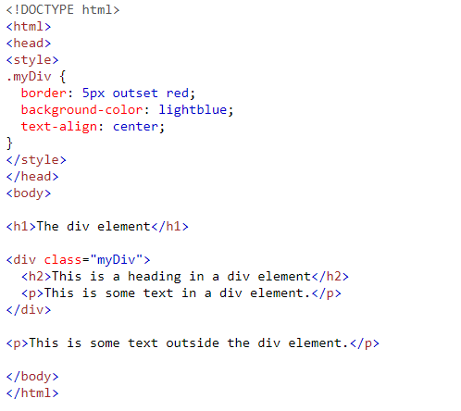
Part II | Div Element
The <div> tag defines a division or a section in an HTML document.
The <div> tag is used as a container for HTML elements - which is then styled with CSS or manipulated with JavaScript.
The <div> tag is easily styled by using the class or id attribute.
Any sort of content can be put inside the <div> tag!
Note: By default, browsers always place a line break before and after the <div> element.
Main Heading | Subheading
2020 CTU Training Solutions | All Rights Reserved | ctutraining.ac.za
2022 CTU Training Solutions | All Rights Reserved | ctutraining.ac.za

Slide 19
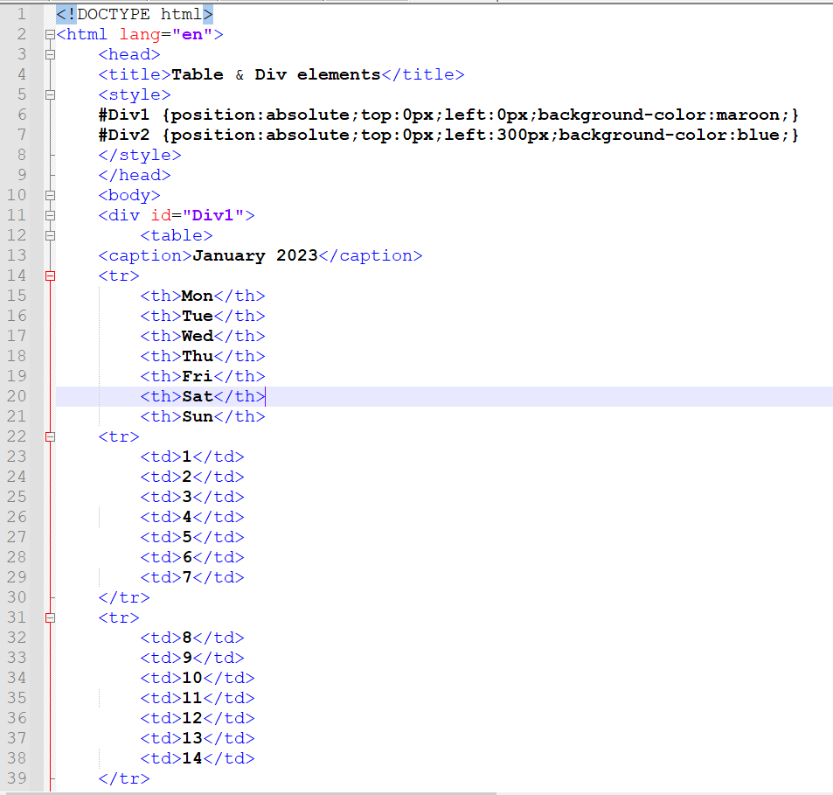
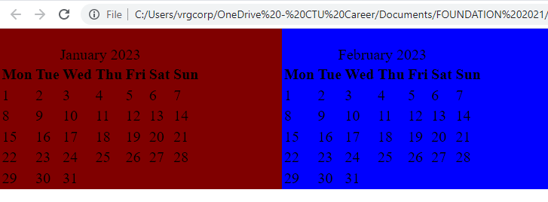
Part II | Div Element
Main Heading | Subheading
2020 CTU Training Solutions | All Rights Reserved | ctutraining.ac.za
2022 CTU Training Solutions | All Rights Reserved | ctutraining.ac.za

Slide 20
Part II | Home-Activity
Main Heading | Subheading
You have been tasked to create a Calendar for 2024. Using the following criteria:
Choose a theme/company for the Calendar.
All holidays should have different formatting(color, bg-color etc..)
All Saturdays and Sundays should have different formatting (color, bg-color etc..)
Add a table showing the descriptions of all the holidays in the year.
Add your own unique creativity.
Reference the following video for inspiration:
2020 CTU Training Solutions | All Rights Reserved | ctutraining.ac.za
2022 CTU Training Solutions | All Rights Reserved | ctutraining.ac.za

Slide 21
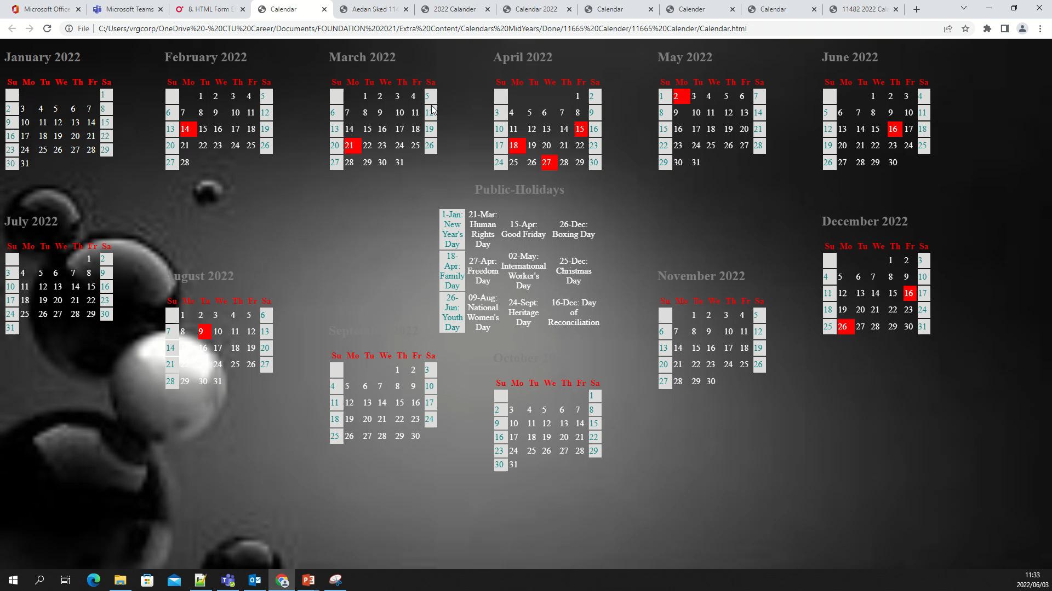
Part II | Examples of Calendars
Main Heading | Subheading
2020 CTU Training Solutions | All Rights Reserved | ctutraining.ac.za
2022 CTU Training Solutions | All Rights Reserved | ctutraining.ac.za

Slide 22
Part II | Form Elements
Using forms in a web page is the most effective way to gather relevant data from the user.
Forms are how users really interact with the application whether it's a search form, a login screen, or a multipage registration wizard.
Forms can have inputs such as name, gender, credit card number, password, images, or upload files into the forms.
Forms on a web page provide an interface where information can be shared between a client and a user more easily and securely in comparison to paper-based forms.
They are a collection of various <input> types, such as textbox, radiobutton, and checkbox, which allow users to perform various actions and simplifies decision making.
Forms have always been a fundamental part of the Web. Without them, various web transactions, discussions, and efficient searches would simply not be possible.
Main Heading | Subheading
2020 CTU Training Solutions | All Rights Reserved | ctutraining.ac.za
2022 CTU Training Solutions | All Rights Reserved | ctutraining.ac.za

Slide 23
Part II | Form Elements
Online forms help the customers to talk to the companies as they contain digitally stored data and deduce that data to meaningful information.
The form owners can quickly build and distribute the HTML5 interface, targeting a large audience.
The form owner can easily update and modify forms as needed.
The Cascading Style Sheets (CSS) and JavaScript attributes allow authors to customize form controls with specific styles and functions.
Web forms are time saving and cost effective as they require no manpower to gather information.
They provide a visibility for decision making, for example, shopping online on websites such as eBay.
As the data is entered directly by the customer, it can be easily sorted to get the required information.
Main Heading | Subheading
2020 CTU Training Solutions | All Rights Reserved | ctutraining.ac.za
2022 CTU Training Solutions | All Rights Reserved | ctutraining.ac.za

Slide 24
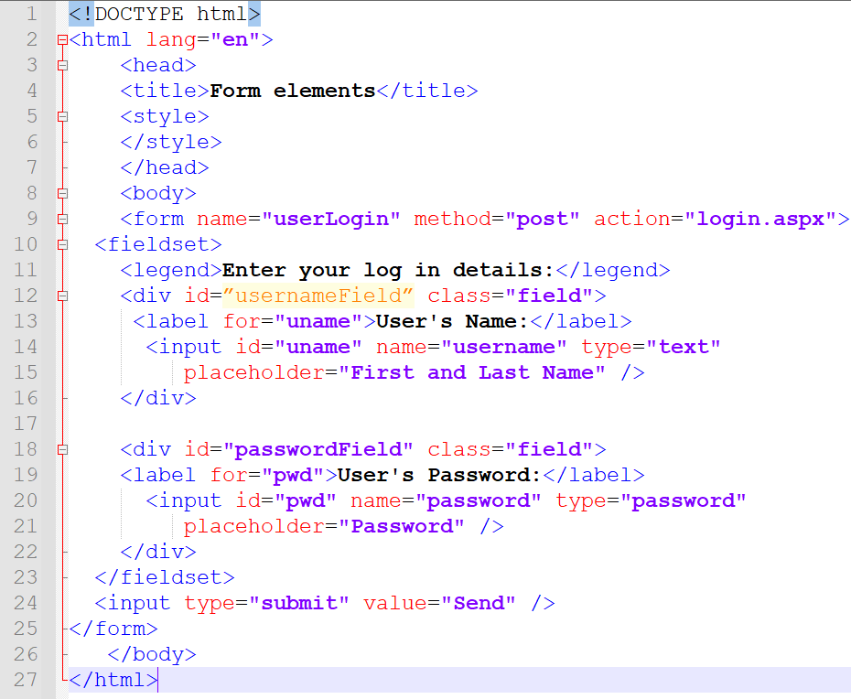
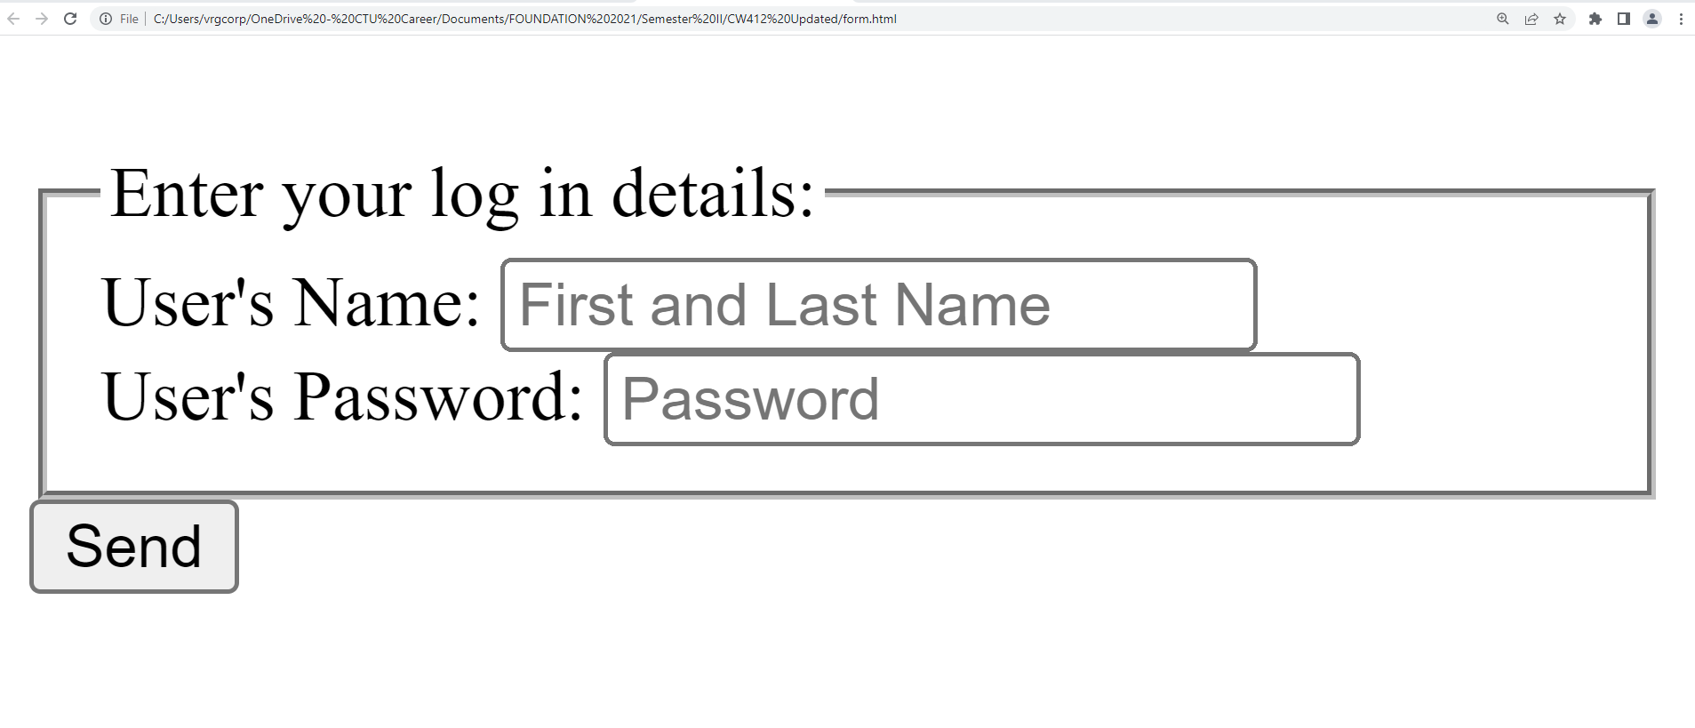
Part II | Form Elements
Main Heading | Subheading
2020 CTU Training Solutions | All Rights Reserved | ctutraining.ac.za
2022 CTU Training Solutions | All Rights Reserved | ctutraining.ac.za
Notes:
The GET method is used to request data from a specified resource. It sends data as part of the URL query string. The POST method is used to submit data to be processed to a specified resource. It sends data in the body of the HTTP request.
The .aspx extension is commonly associated with ASP.NET Web Forms, a web application framework developed by Microsoft.

Slide 25
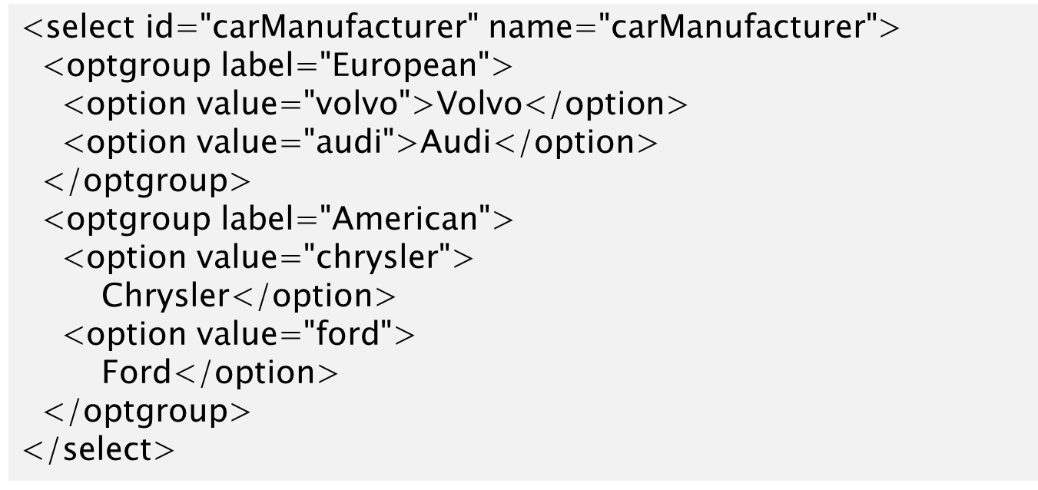
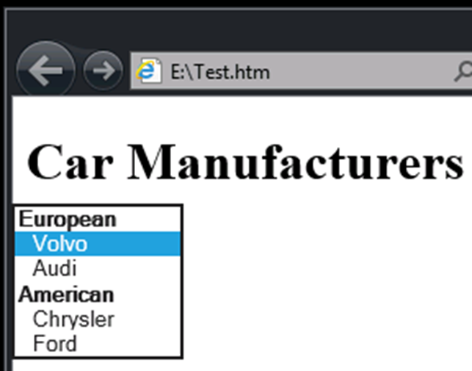
Part II | Form Elements
HTML5 defines a wide range of new input types and elements, but not all are widely implemented.
Main Heading | Subheading
2020 CTU Training Solutions | All Rights Reserved | ctutraining.ac.za
2022 CTU Training Solutions | All Rights Reserved | ctutraining.ac.za

Slide 26
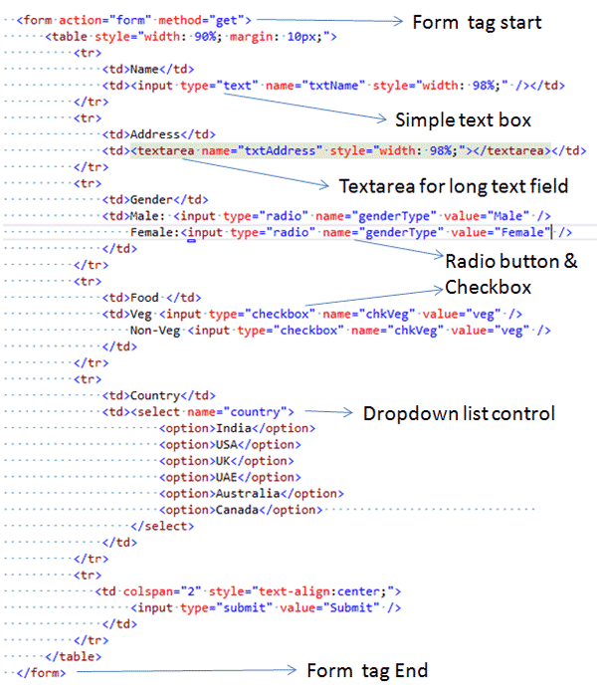
Part II | Form Elements
Input attributes modify the behavior of input types and forms to provide better feedback and usability:
autofocus
autocomplete
required
pattern
placeholder
many other input type-specific attributes
Main Heading | Subheading
2020 CTU Training Solutions | All Rights Reserved | ctutraining.ac.za
2022 CTU Training Solutions | All Rights Reserved | ctutraining.ac.za

Slide 27
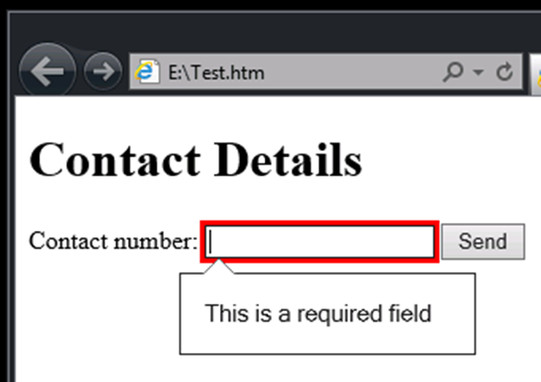
Part II | Principles of Validation
User input can vary in accuracy, quality, and intent
Client-side validation improves the user experience
Server-side validation is still necessary
Use the required attribute to indicate mandatory fields
The browser checks that they are filled in before submitting the form
Main Heading | Subheading
2020 CTU Training Solutions | All Rights Reserved | ctutraining.ac.za
2022 CTU Training Solutions | All Rights Reserved | ctutraining.ac.za

Slide 28
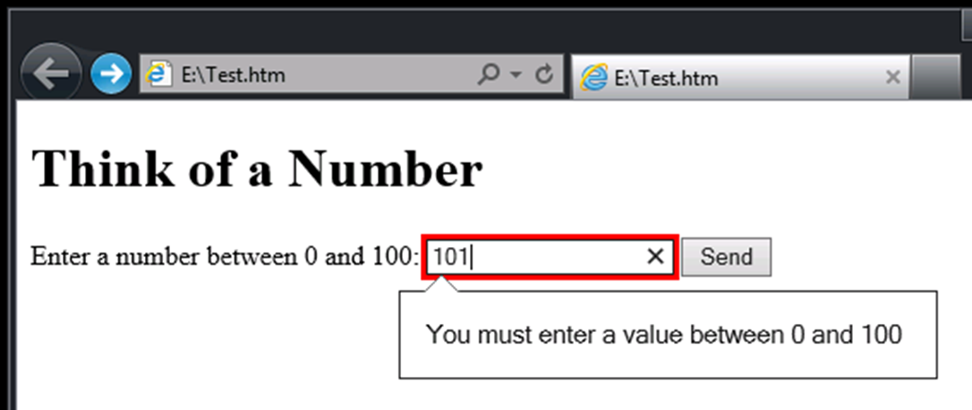
Part II | Validating Numeric Input
Main Heading | Subheading
Use the min and max attributes to specify the upper and lower limit for numeric data
2020 CTU Training Solutions | All Rights Reserved | ctutraining.ac.za
2022 CTU Training Solutions | All Rights Reserved | ctutraining.ac.za

Slide 29
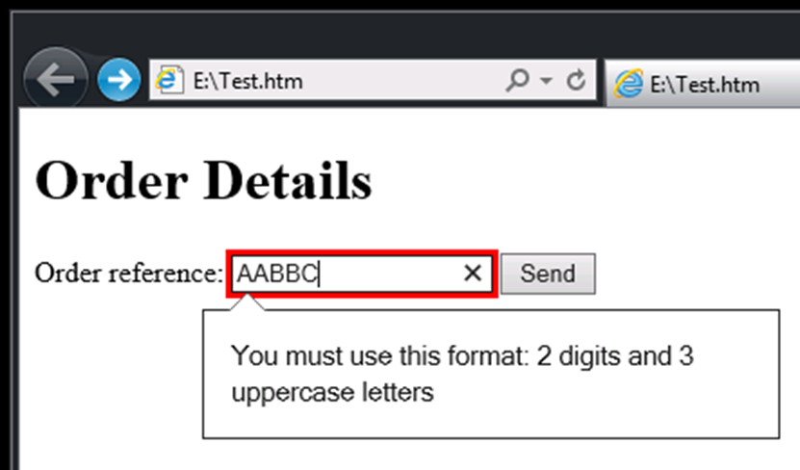
Part II | Validating Text Input
Main Heading | Subheading
Use the pattern attribute to validate text-based input by using a regular expression
2020 CTU Training Solutions | All Rights Reserved | ctutraining.ac.za
2022 CTU Training Solutions | All Rights Reserved | ctutraining.ac.za

Slide 30
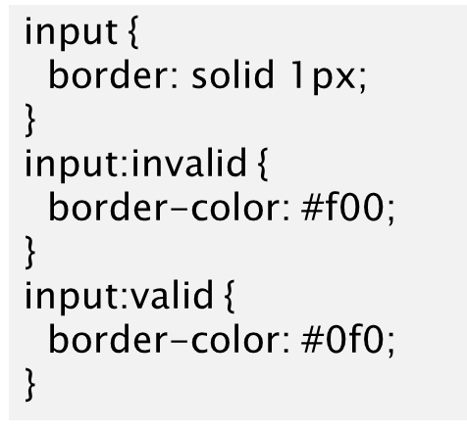
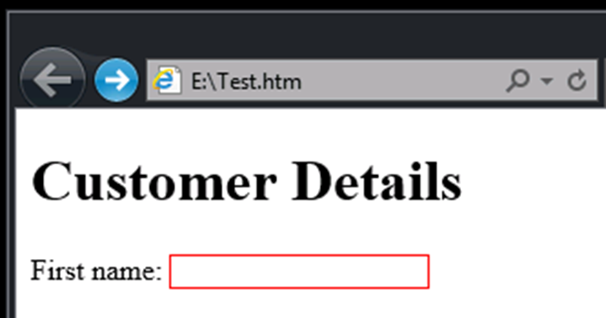
Part II | Styling Fields to Provide Feedback
Main Heading | Subheading
Use CSS to style input fields
Use the valid and invalid pseudo-classes to detect fields that have passed or failed validation
2020 CTU Training Solutions | All Rights Reserved | ctutraining.ac.za
2022 CTU Training Solutions | All Rights Reserved | ctutraining.ac.za

Slide 31
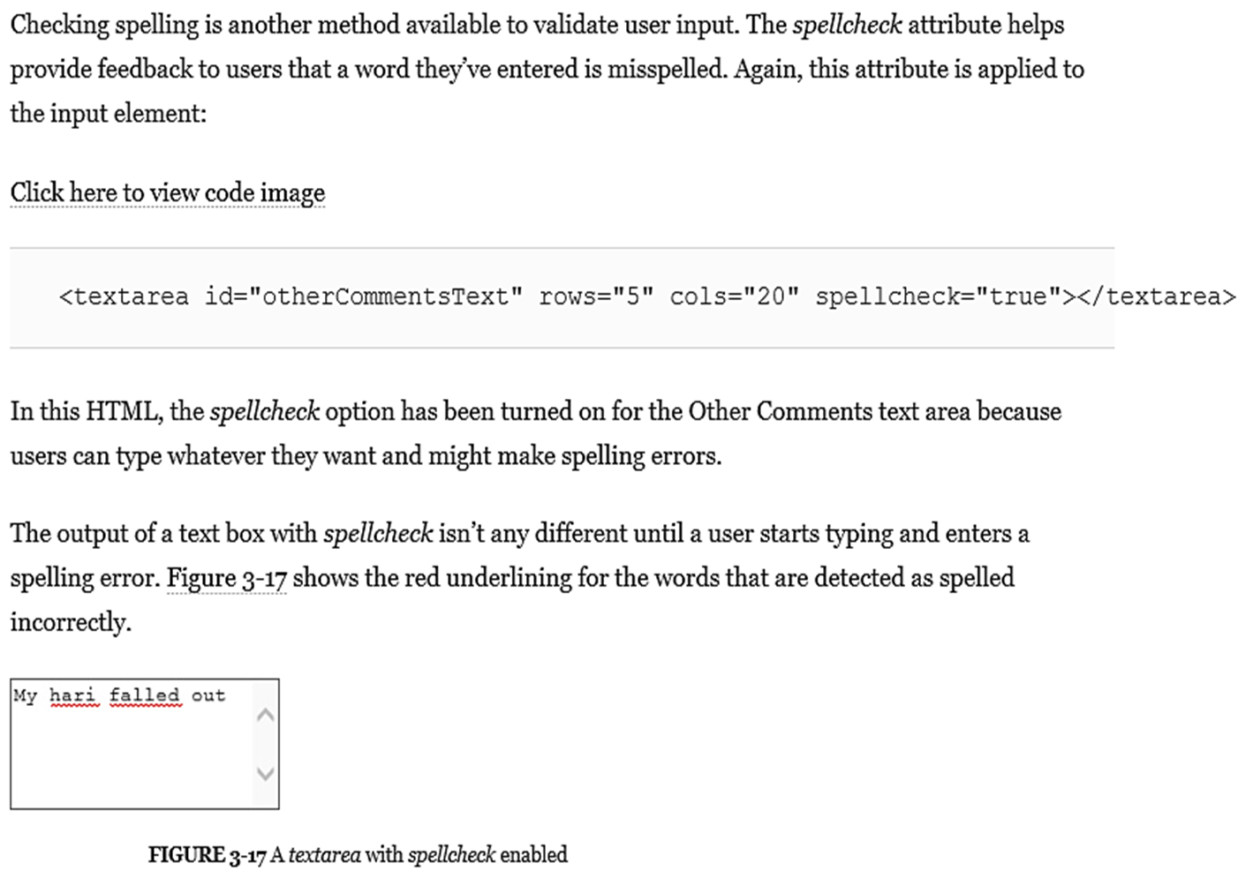
Part II | Providing a spelling checker
Main Heading | Subheading
2020 CTU Training Solutions | All Rights Reserved | ctutraining.ac.za
2022 CTU Training Solutions | All Rights Reserved | ctutraining.ac.za

Slide 32
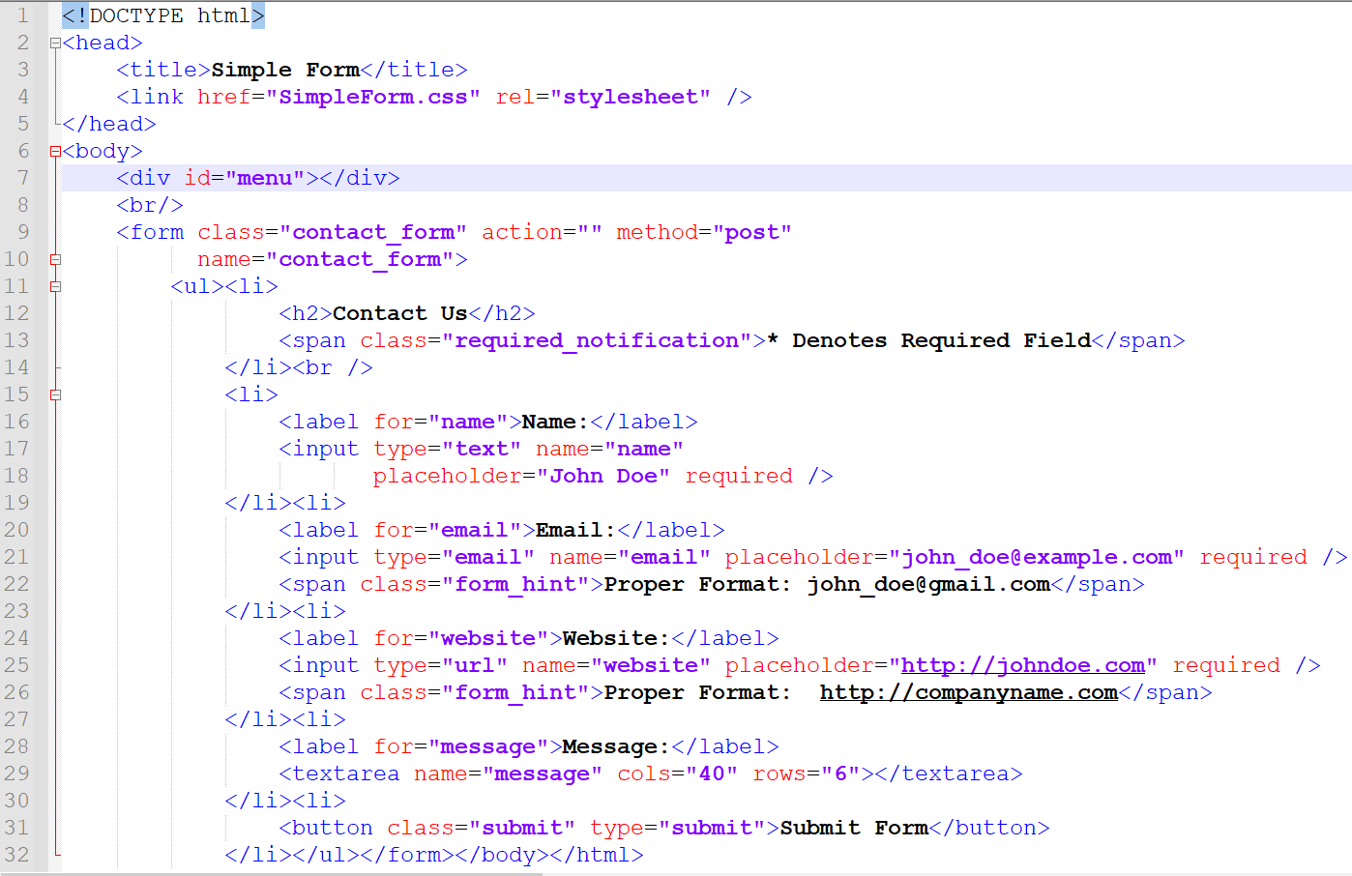
Part II | Simple Form with Validation
Main Heading | Subheading
2020 CTU Training Solutions | All Rights Reserved | ctutraining.ac.za
2022 CTU Training Solutions | All Rights Reserved | ctutraining.ac.za

Slide 33
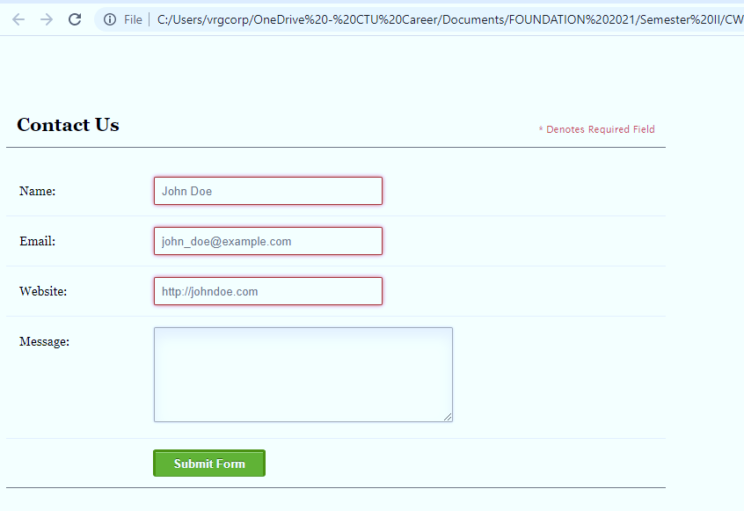
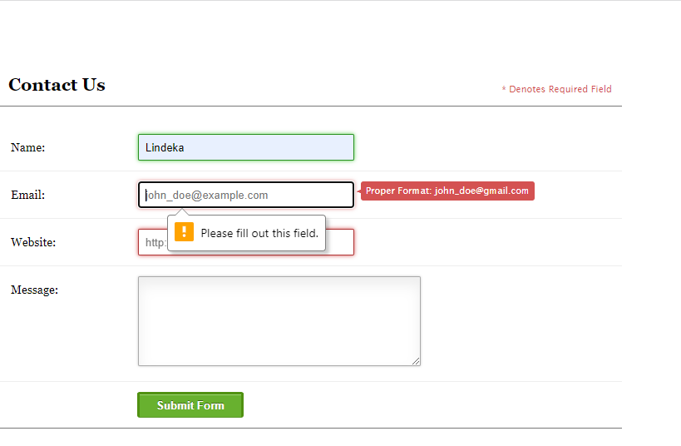
Part II | Simple Form with Validation
Main Heading | Subheading
2020 CTU Training Solutions | All Rights Reserved | ctutraining.ac.za
2022 CTU Training Solutions | All Rights Reserved | ctutraining.ac.za

Slide 34
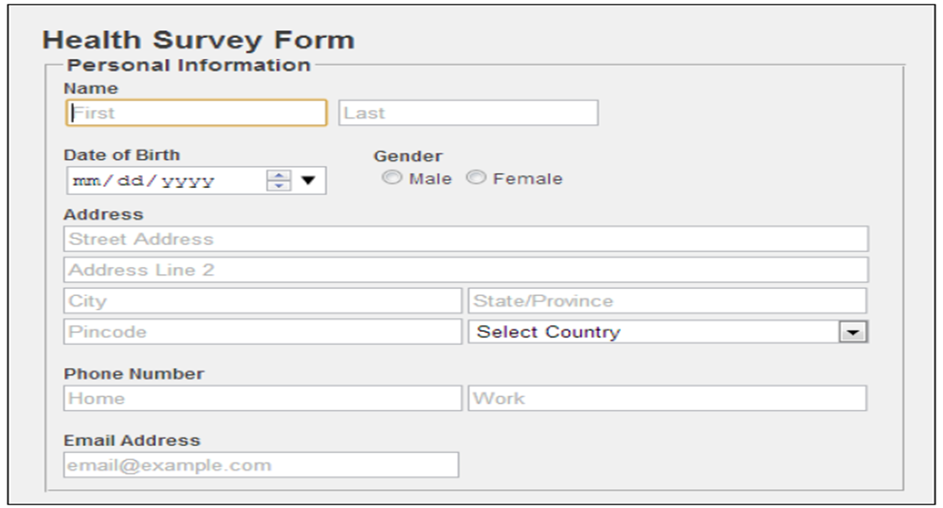
Part II | Home-Activity
Main Heading | Subheading
2020 CTU Training Solutions | All Rights Reserved | ctutraining.ac.za
2022 CTU Training Solutions | All Rights Reserved | ctutraining.ac.za

Slide 35
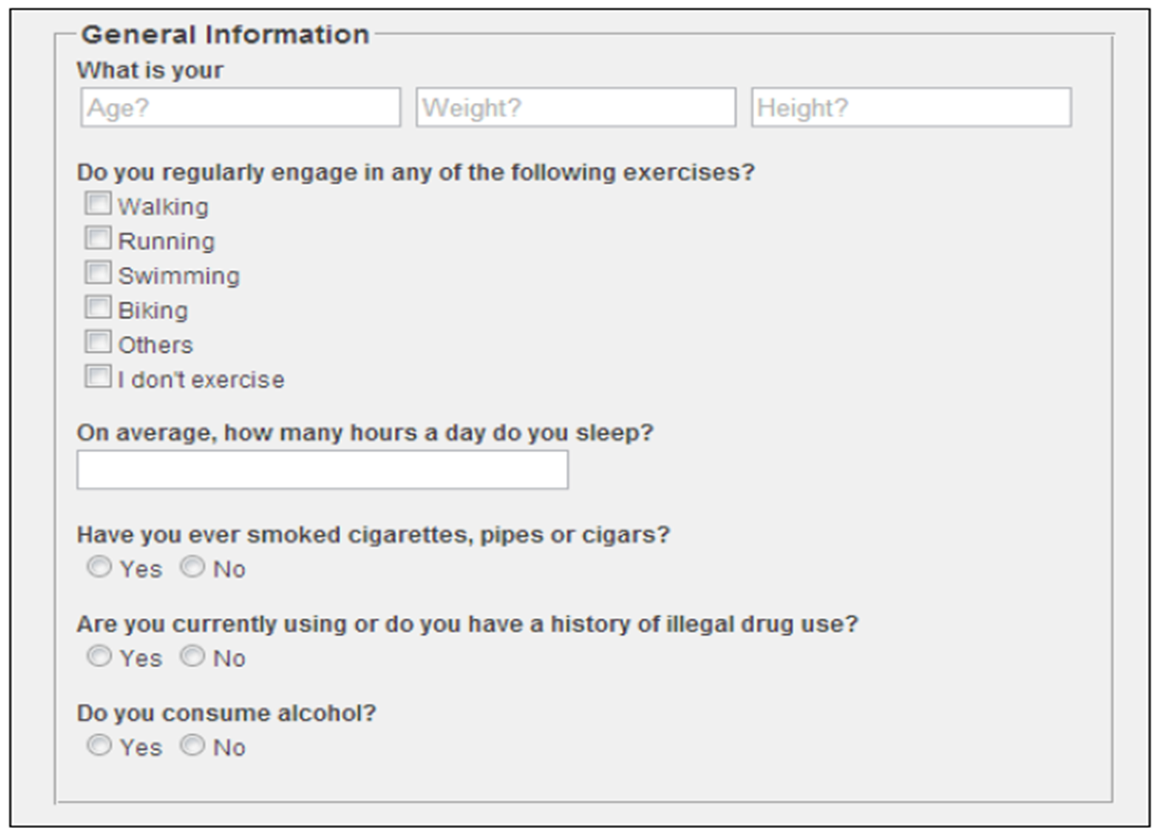
Part II | Home-Activity
Main Heading | Subheading
2020 CTU Training Solutions | All Rights Reserved | ctutraining.ac.za
2022 CTU Training Solutions | All Rights Reserved | ctutraining.ac.za

Slide 36
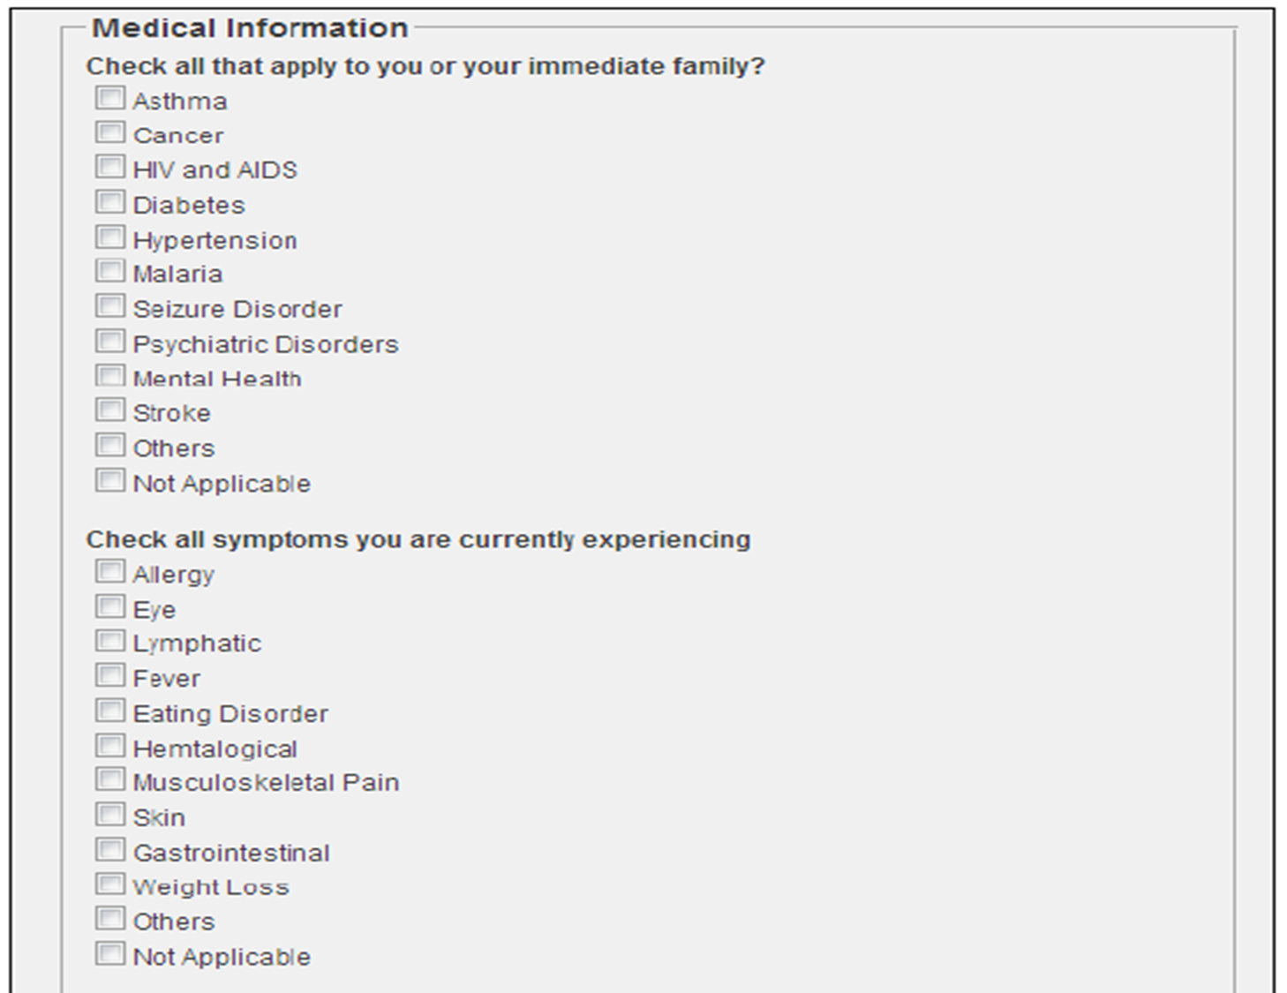
Part II | Home-Activity
Main Heading | Subheading
2020 CTU Training Solutions | All Rights Reserved | ctutraining.ac.za
2022 CTU Training Solutions | All Rights Reserved | ctutraining.ac.za

Slide 37
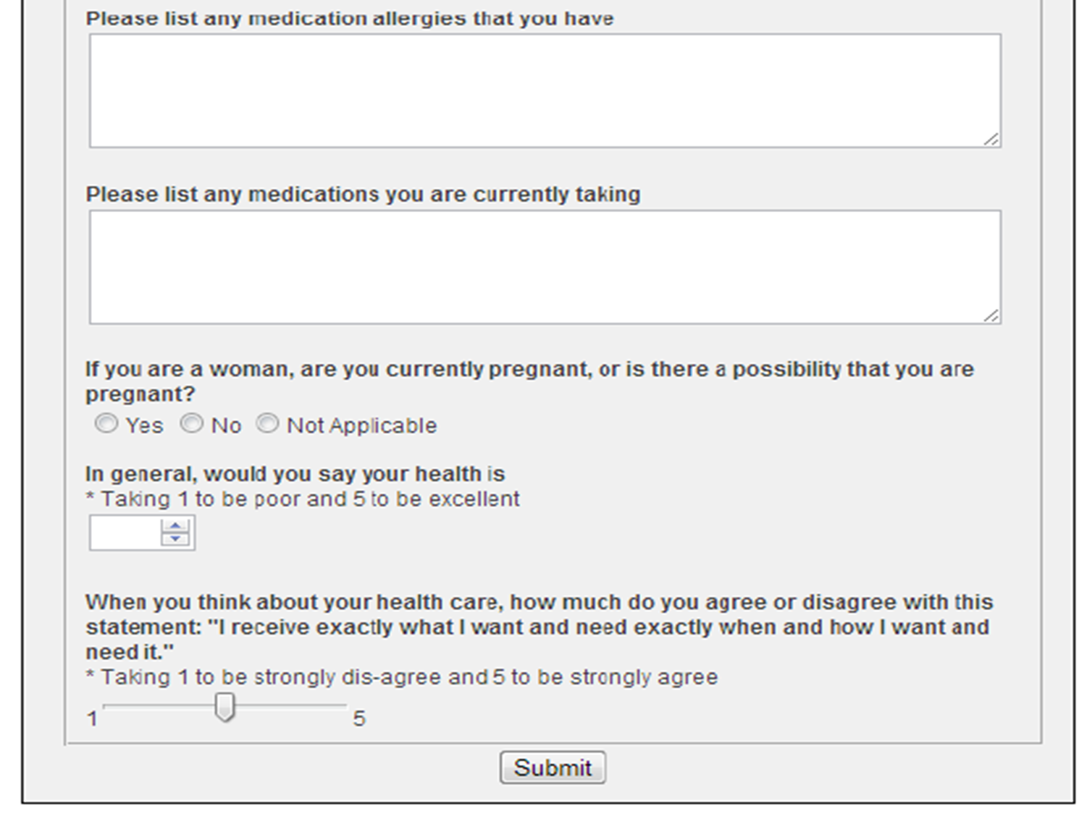
Part II | Home-Activity
Main Heading | Subheading
2020 CTU Training Solutions | All Rights Reserved | ctutraining.ac.za
2022 CTU Training Solutions | All Rights Reserved | ctutraining.ac.za

Slide 38
EMBED HTML Elements.
OBJECTIVE 3

Slide 39
Part II | Embed HTML Elements
The three most common embedded elements are images (img), audio, and video.
Both audio and video elements are also considered interactive elements because a user will often manipulate them through the UI. For example, they may want to play, pause, rewind, or adjust the volume.
HTML5 also supports the embedded (embed) and object elements that allow you to reference custom plug-ins that will render this content. The other embedded elements, scalar-vector graphics (svg) and canvas, require their own chapter to fully describe, which will do in Chapters 22 and 23 respectively.
Main Heading | Subheading
2020 CTU Training Solutions | All Rights Reserved | ctutraining.ac.za
2022 CTU Training Solutions | All Rights Reserved | ctutraining.ac.za

Slide 40
Part II | Anchor Element
The anchor (a) element is not technically categorized as embedded content. Included here because it doesn’t fit well in any other chapter. However, the understanding of anchor elements (and navigating to other resources in general) is needed for this and future chapters.
The <a> tag defines a hyperlink, which is used to link from one page to another.
The most important attribute of the <a> element is the href attribute, which indicates the link's destination.
By default, links will appear as follows in all browsers:
An unvisited link is underlined and blue
A visited link is underlined and purple
An active link is underlined and red
Main Heading | Subheading
2020 CTU Training Solutions | All Rights Reserved | ctutraining.ac.za
2022 CTU Training Solutions | All Rights Reserved | ctutraining.ac.za

Slide 41
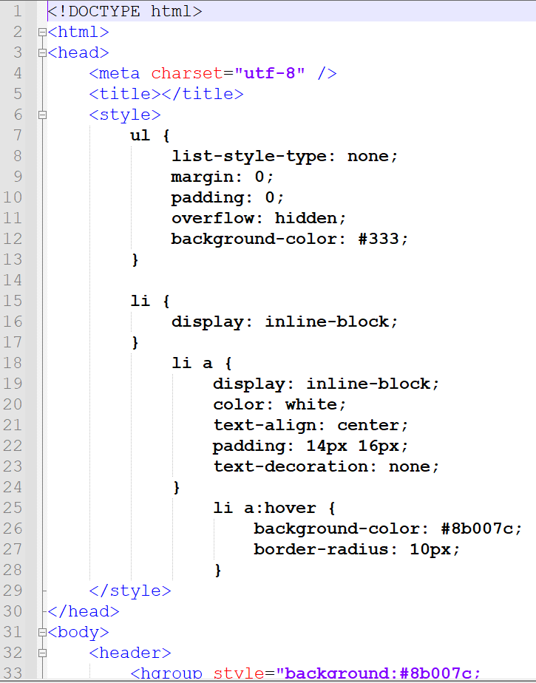
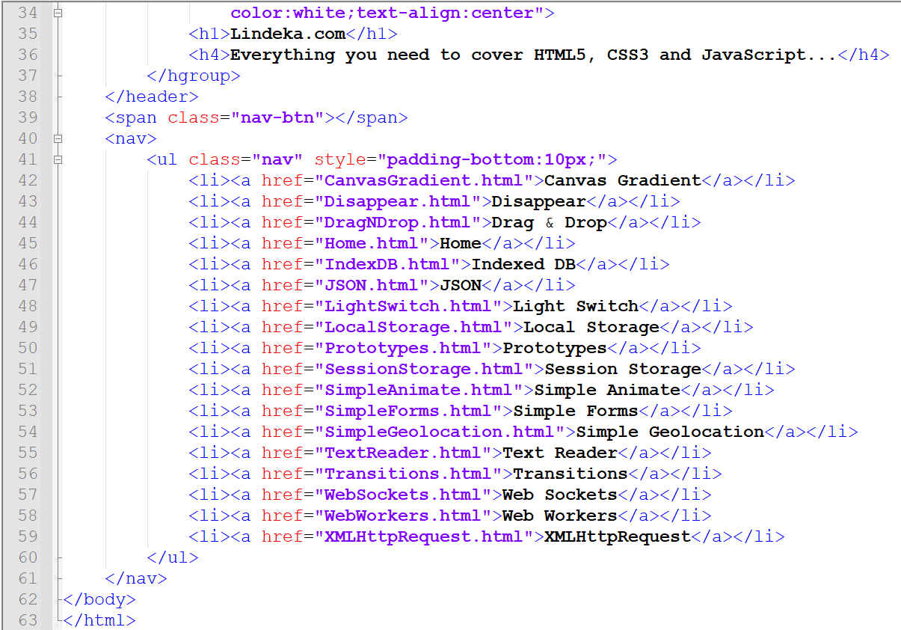
Part II | Anchor Element
Main Heading | Subheading
2020 CTU Training Solutions | All Rights Reserved | ctutraining.ac.za
2022 CTU Training Solutions | All Rights Reserved | ctutraining.ac.za

Slide 42
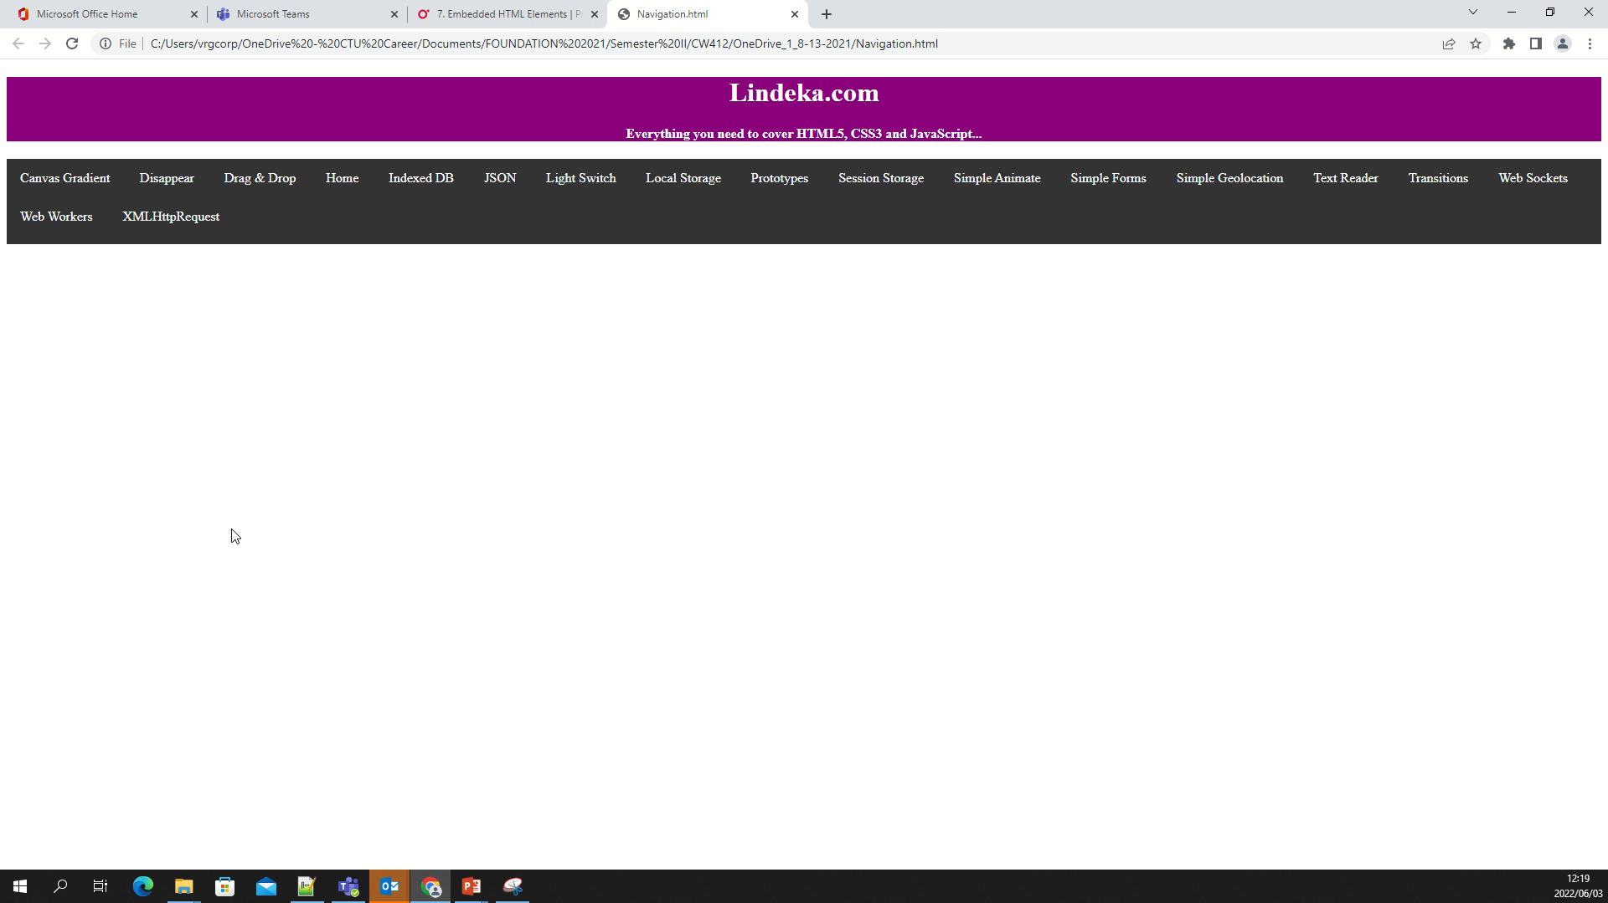
Part II | Output
Main Heading | Subheading
2020 CTU Training Solutions | All Rights Reserved | ctutraining.ac.za
2022 CTU Training Solutions | All Rights Reserved | ctutraining.ac.za

Slide 43
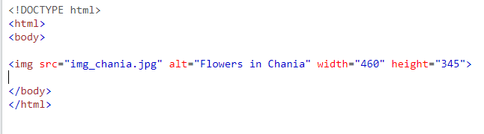
Part II | Image Element
Images can improve the design and the appearance of a web page.
The HTML <img> tag is used to embed an image in a web page.
Images are not technically inserted into a web page; images are linked to web pages. The <img> tag creates a holding space for the referenced image.
The <img> tag is empty, it contains attributes only, and does not have a closing tag.
The <img> tag has two required attributes:
src - Specifies the path to the image
alt - Specifies an alternate text for the image
Main Heading | Subheading
2020 CTU Training Solutions | All Rights Reserved | ctutraining.ac.za
2022 CTU Training Solutions | All Rights Reserved | ctutraining.ac.za

Slide 44
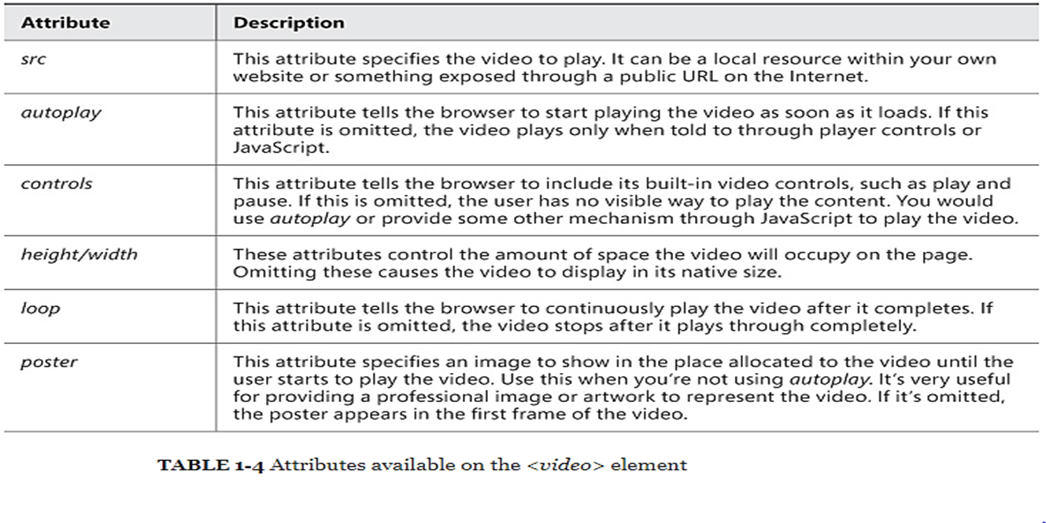
Part II | Video Element
Embedding a video in the page is as simple as adding the following markup:
<video src="samplevideo.mp4" autoplay> </video>
Main Heading | Subheading
2020 CTU Training Solutions | All Rights Reserved | ctutraining.ac.za
2022 CTU Training Solutions | All Rights Reserved | ctutraining.ac.za

Slide 45
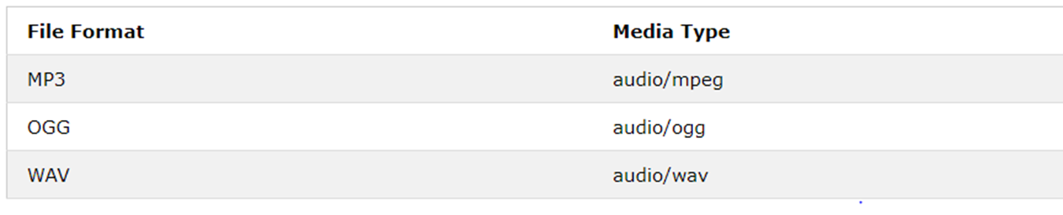
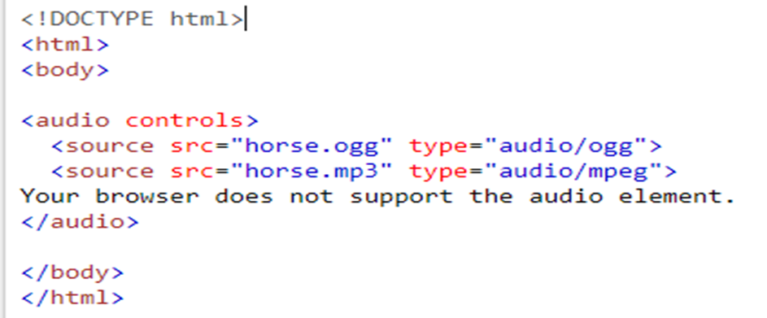
Part II |Audio Element
The <audio> element is essentially identical to the <video> element. It has all the same attributes and the same methods. The only real difference is how it displays in the browser.
Main Heading | Subheading
2020 CTU Training Solutions | All Rights Reserved | ctutraining.ac.za
2022 CTU Training Solutions | All Rights Reserved | ctutraining.ac.za

Slide 46
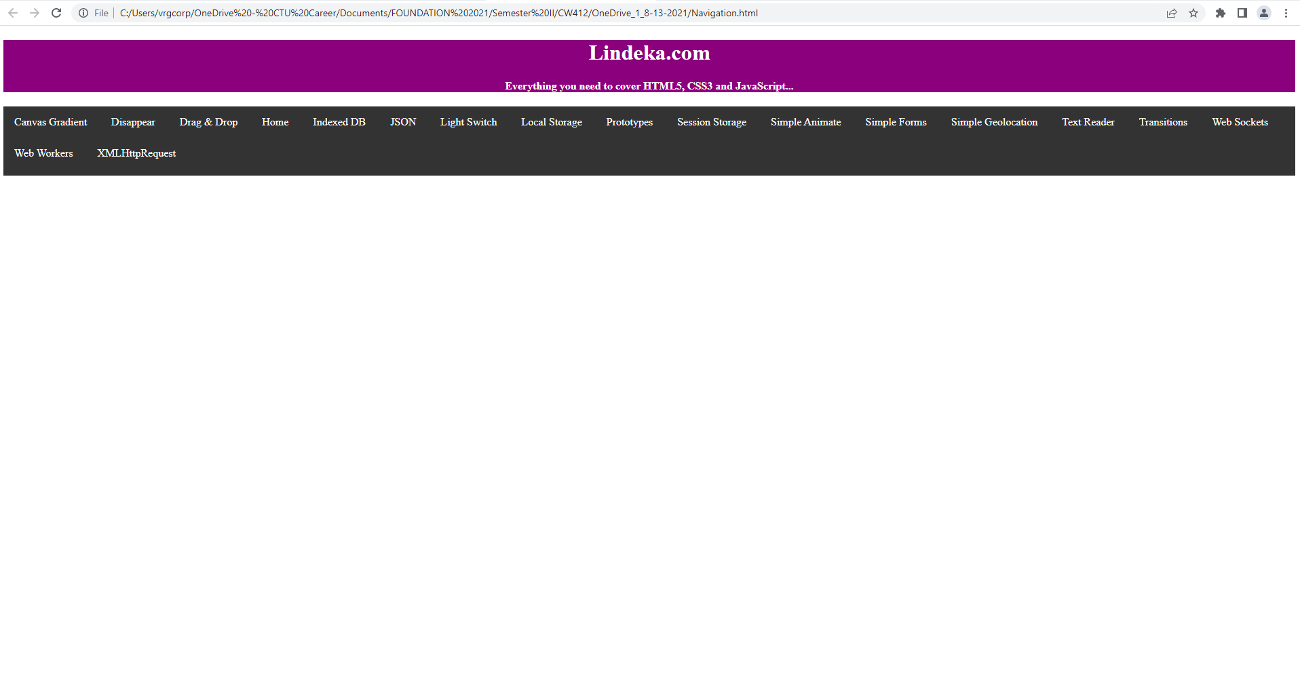
Part II |Class-Activity
Add audio, your image(Picture of yourself) And a video to this web page:
Main Heading | Subheading
2020 CTU Training Solutions | All Rights Reserved | ctutraining.ac.za
2022 CTU Training Solutions | All Rights Reserved | ctutraining.ac.za

Slide 47
COURSE OUTLINE
PART I HTML5 Technologies | PART II HTML | PART III CSS | PART IV JAVASCRIPT | PART V Advanced Applications
Chapter 1:​ Hypertext Markup Language | Chapter 4:​ Structural HTML Elements | Chapter 9:​ CSS Selectors | Chapter 16:​ Browser Environment | Chapter 21:​ Audio and Video
Chapter 2:​ Cascading Style Sheets | Chapter 5:​ Phrasing HTML Elements | Chapter 10:​ Positioning | Chapter 17:​ Window Object | Chapter 22:​ Scalable Vector Graphics
Chapter 3:​ JavaScript Essentials | Chapter 6:​ Table HTML Elements | Chapter 11:​ Text Styles | Chapter 18:​ DOM Elements | Chapter 23:​ Canvas
 | Chapter 7:​ Embedded HTML Elements | Chapter 12:​ Borders and Backgrounds | Chapter 19:​ Dynamic Styling | Chapter 24:​ Drag and Drop
 | Chapter 8:​ HTML Form Elements | Chapter 13:​ Styling Tables | Chapter 20:​ Events | Chapter 25:​ Indexed DB
 |  | Chapter 14:​ Flexbox |  | Chapter 26:​ Geolocation and Mapping
 |  | Chapter 15:​ Animation and Transforms
2022 CTU Training Solutions | All Rights Reserved | ctutraining.ac.za
Notes:
By understanding and applying HTML elements, tables, and forms, students can create structured and interactive web pages that meet a user’s design and functionality requirements.

Slide 48
CW412 | THE END | PART II
Thank you for participating ☺

